Slide 1
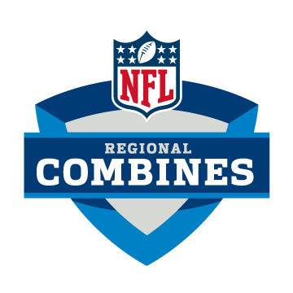
Measuring NFL success by NFL Combine results
By: Joe Cheng
Giovanni Rigters
Lucy Hohler

Slide 2
What is NFL Combine?
The NFL combine is an invitational event to test NFL hopefuls on their athletic ability
General Managers, Scouts and Personal Executives evaluate combine participants on their speed, power, agility, strength, and explosiveness as it relates to size
Each drill has a practical application for the movements these players are going to have to make on the field

Slide 3
Objectives
The purpose of this project is to see if there is a correlation between the combine drill results and NFL success
We will look at 5+ years worth of combine data to test our results. To measure “success”; we will use pro bowl appearances
Our goal is to identify a correlation between drill performance and NFL pro bowl appearances

Slide 4
NFL Combine Drills – 40 Yard Dash
The test is exactly what it sounds like: A player runs 40 yards in a straight line.
What does it measures?
Straight line-speed
Break-away ability

Slide 5
NFL Combine Drills – Vertical Jump
What does it measures?
Leaping ability
Comes in handy for receivers, running backs, cornerbacks, and safeties

Slide 6
NFL Combine Drills – Broad Jump
What does it measures?
Lower-body power
Balance
Flexibility
Explosiveness

Slide 7
NFL Combine Drills – Three-Cone Drill
What does it measures?
Lateral agility
Change of direction
Acceleration
Coordination

Slide 8
NFL Combine Drills – Shuttle
What does it measures?
Ability to change direction
Maintain balance
Acceleration
Short-area quickness

Slide 9
NFL Combine Drills – Bench
What does it measures?
Strength
Power

Slide 10
40 Yard Dash continue

